Slide 1
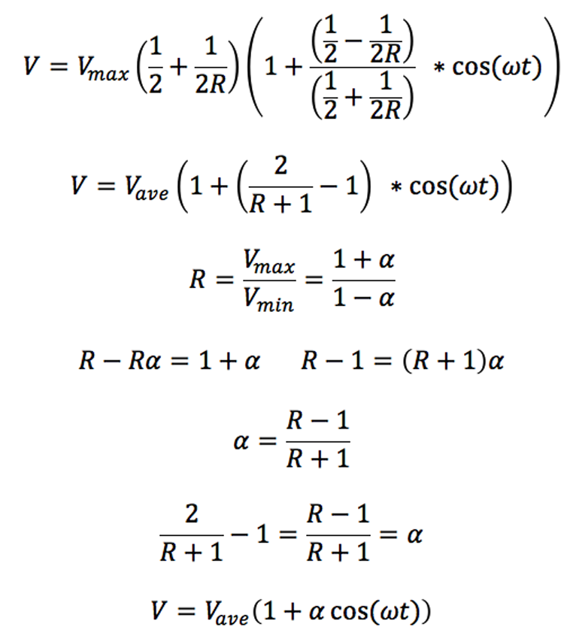
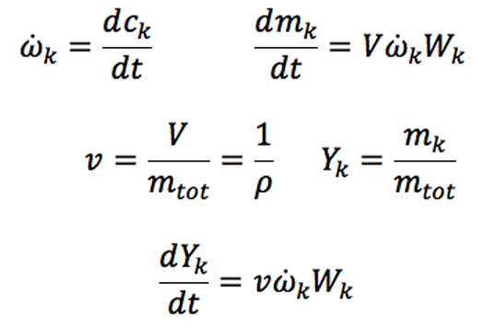
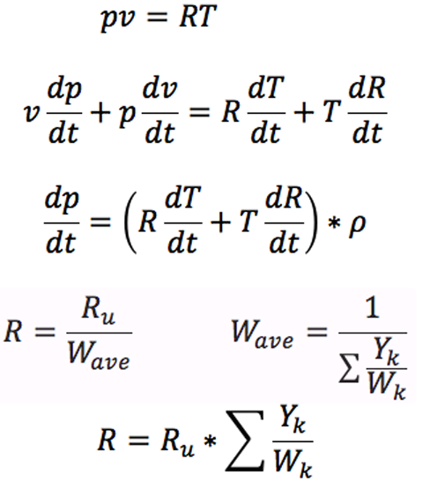
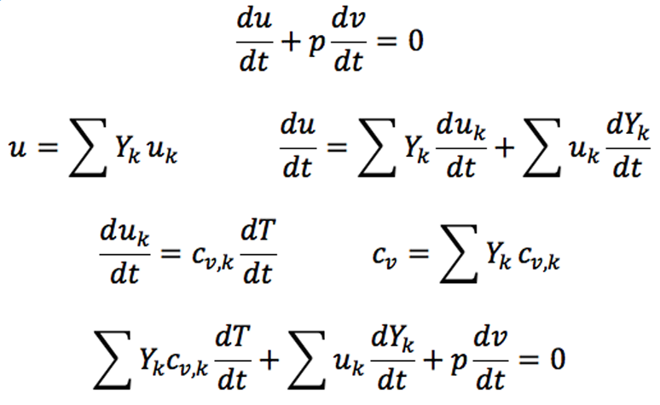
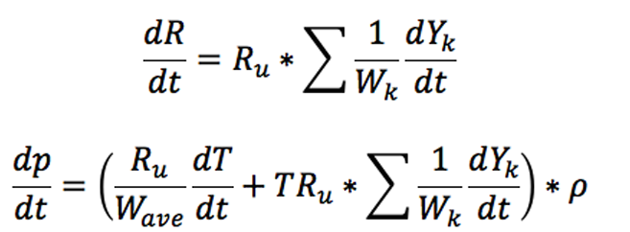
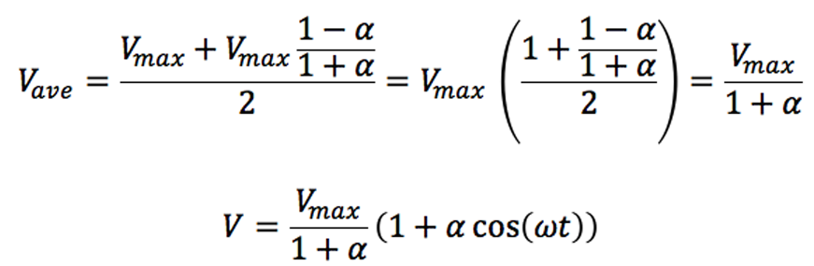
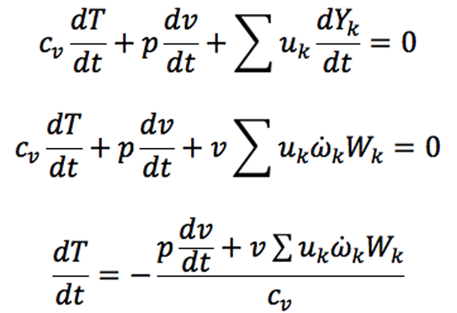
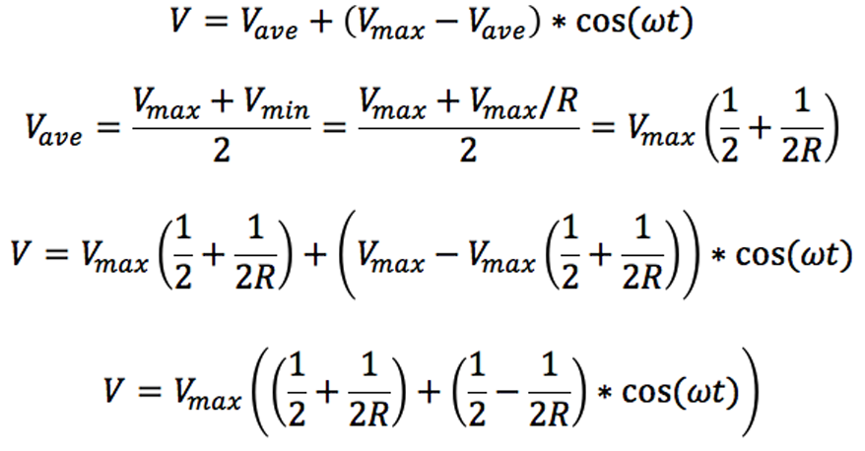
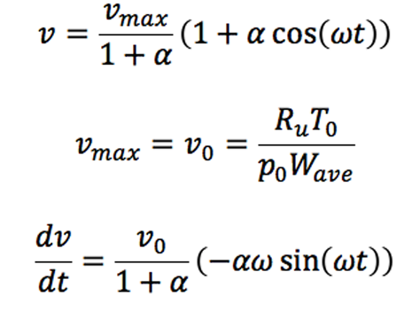
Derivation for Homogenous Reacting Gas Mixture in Closed System
An adiabatic system with volume as a function of time, simulating a HCCI engine
Species Equation
Pressure Equation from Ideal Gas Law
Energy Equation
Volume Equation
R = V_{max} / V_{min} = compression ratio
f = rotation frequency
ω = 2πf = angular velocity
Total mass must be constant, the system is closed and no nuclear reactions, therefore I can convert volume to specific volume

